Slide 1
CAR SALES PITCH
By Gomolemo moabalobelo

Slide 2
Table of content
1. Introduction 3
2. Car Brand Revenue Analysis ...... 4–10
2.1 Revenue by Model, Mileage, and Year 4
2.2 Revenue by Region and Year 5
2.3 Revenue by Day of the Week and Daily Trends 6
2.4 Revenue by Month and Mileage 7
2.5 Revenue by Color 8–10
3. RECOMMENDATION 11
4.CONCLUSION 12

Slide 3
INTRODUCTION
    With the recent appointment of a new Head of Sales, tasked with expanding the dealership network, improving sales performance, and optimizing inventory management, this analysis is designed to provide valuable, data-driven insights to support these objectives.
    In my role as a Junior Data Analyst, I examine historical car sales data to identify trends and patterns across key factors such as brand, model, mileage, region, time period, and color.
    The results of this analysis will inform strategic decisions in sales, marketing, and inventory planning, contributing to sustained growth and greater operational efficiency at Bright Motors.

Slide 4
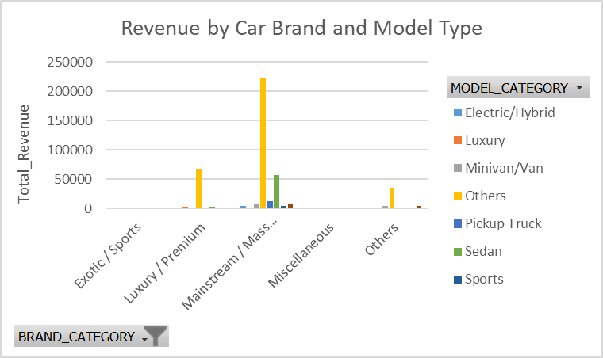
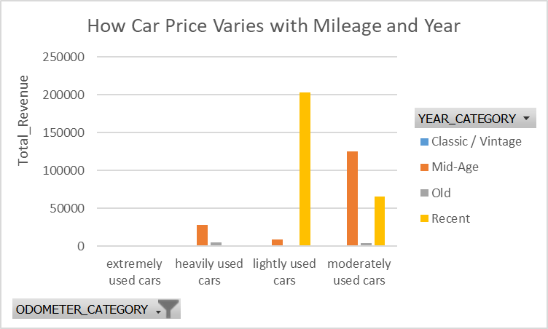
Car Brand Revenue by model, mileage and year
Overall, consumer demand declines significantly as vehicle mileage increases.
Across almost all car brands, other car models are most preferred. Within mainstream brands, the sedan model is the second most preferred, followed by the pickup truck model.
In recent years, lightly used vehicles have overwhelmingly dominated the market (99.99%) compared to extremely used cars (0.01%), indicating a strong buyer preference for newer models with lower mileage.
In mid-age years, moderately used cars remain the most purchased (99.7%), while extremely used vehicles show a slight increase (0.3%), suggesting that as vehicles age, buyers become more accepting of higher mileage when accompanied by reasonable pricing.

Slide 5
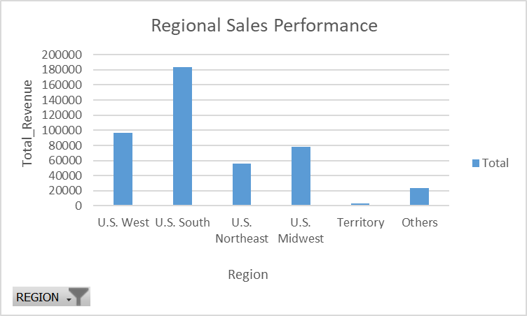
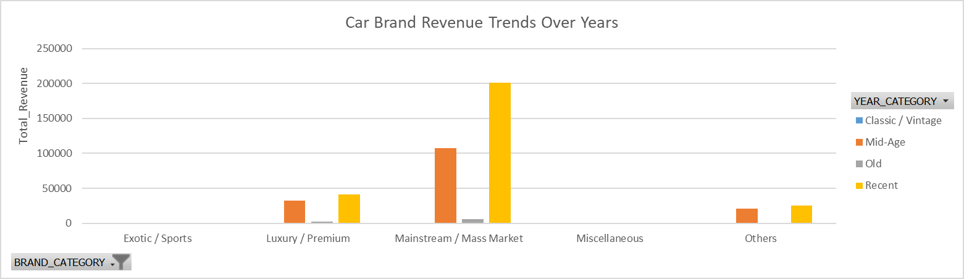
Car Brand Revenue by Region AND year
The graph demonstrate a clear concentration of sales in the US South, moderate performance in the US West, and negligible contribution from the Territory region.
Revenue trends show that mainstream vehicles dominate across all age categories.
The US South emerges as the strongest performing region, accounting
for roughly 41.8% of total sales, highlighting its dominant contribution
to overall revenue.
The US West follows with about 21.9%, indicating a moderate but
significant market presence.
In contrast, the Territory region records minimal activity, (0.8%),
reflecting limited market engagement.
In recent years (74.82%), while luxury and other brands hold smaller shares.
Mid-age vehicles see a slight decline in mainstream revenue (66.25%) and a corresponding increase for luxury (19.97%) and other brands (13.02%).
Older and vintage vehicles generate the least revenue, reflecting lower demand and market availability.

Slide 6
Car bRAND Revenue by DAY OF THE WEEK and daily
Evening transactions generate the highest volume of sales across all brands, indicating a clear preference among buyers for late-day purchases.
Car purchases overwhelmingly occur on weekdays, accounting for 99.97% of total sales, while weekend sales are negligible at 0.03%.
Mainstream vehicles consistently dominate sales throughout the day, accounting for approximately 68–72% of transactions across all time periods.
Luxury automobiles exhibit a marginally higher proportion of sales in the afternoon (23.7%) compared to the morning (18%) and evening (16.8%).
Other brands represent a relatively small share of total sales, ranging from 9–11%, with slightly higher proportions observed during the morning and evening than in the afternoon.
Mainstream cars dominate weekday sales (64.7%) but drop to 50% on weekends.
Luxury vehicles maintain a modest share (15.5% weekdays, 8.5% weekends).
other brands, though minor during weekdays (9.7%), rise to 41.8% of weekend sales, indicating weekend buyers are more likely to choose alternative brands.

Slide 7
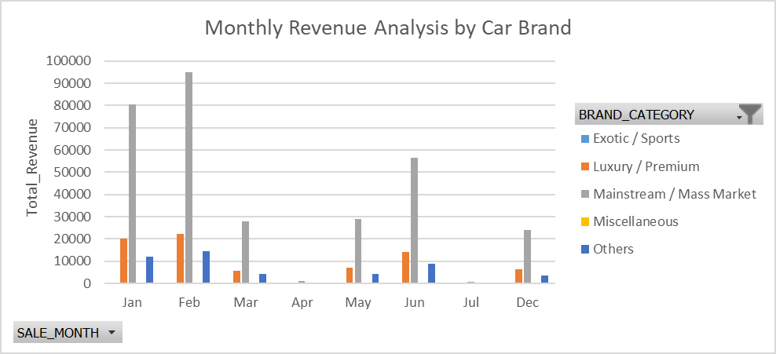
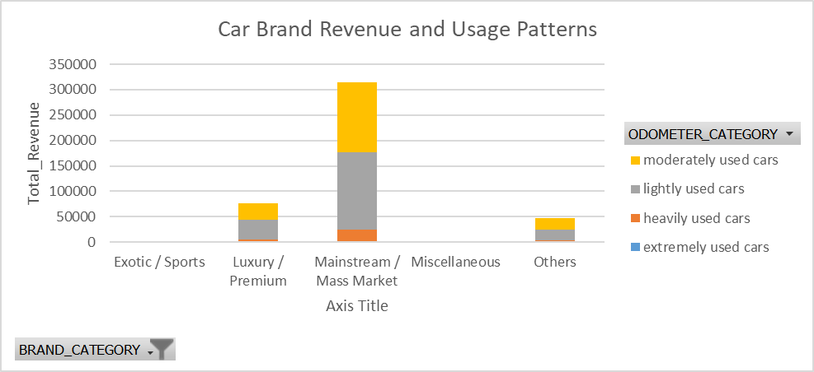
Car BRAND Revenue by MONTH and MILLEAGE
Mainstream brands are purchased consistently throughout the months, followed by luxury brands, with other brands ranking third in overall purchases.
Mainstream cars are the most frequently purchased across all usage categories, with percentages exceeding 70%, followed by luxury brands at 16% and above, while other brands are the least purchased, with percentages starting from 9%.
Mainstream brands record their highest sales in February (71.84%) and the lowest in July (63.80%). Luxury brands peak in February (16.69%) and decline to their lowest in April (11.40%). Other brands also sell most in February (10.89%) and least in April (10.70%).
This trend indicates a seasonal preference, with February being the peak month for car purchases across all brand categories.
This indicates that moderately used cars continue to appeal to buyers seeking a balance between cost and acceptable vehicle condition. Consumers show a clear preference for low-mileage, high-quality vehicles, whereas heavily used cars are less favored due to higher risks and potential maintenance costs.

Slide 8
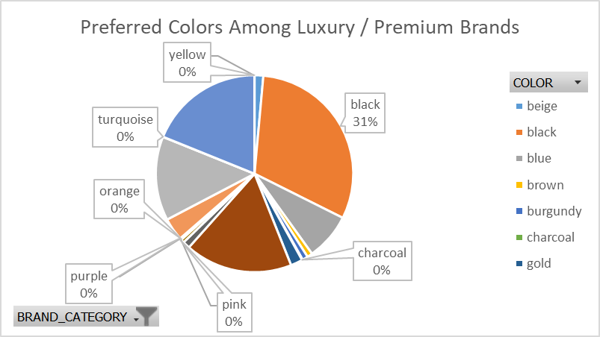
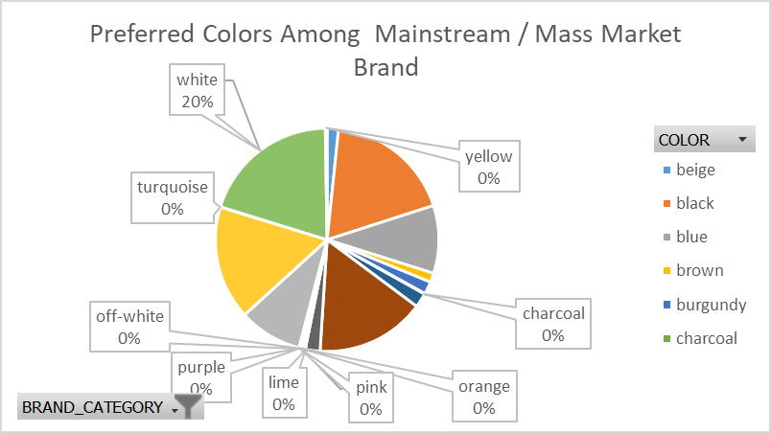
Car BRAND Revenue by COLOR
In the luxury or premium car segment, black vehicles are the most commonly purchased, highlighting a strong preference among buyers for this color. Conversely, colors such as yellow, turquoise, purple, lime, pink, orange, and charcoal are less popular, resulting in comparatively lower sales.
In the mainstream or mass-market segment, white cars are the most widely sold, reflecting strong buyer preference for this color. In contrast, colors such as yellow, turquoise, off-white, purple, lime, pink, orange, and charcoal are less favored and see significantly lower sales.

Slide 9
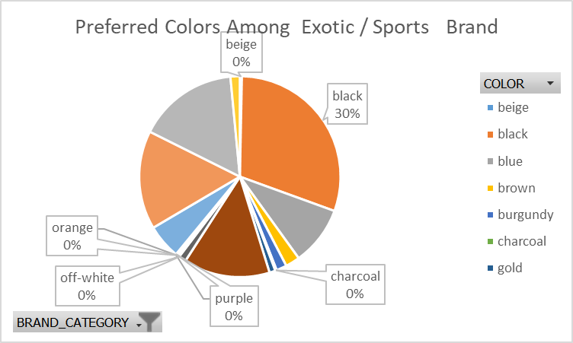
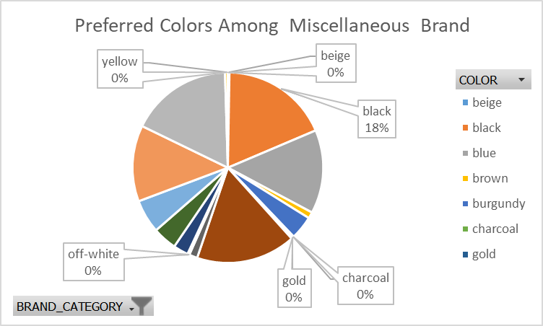
Car BRAND Revenue by COLOR
In exotic and sports car brands, black cars are the top choice among buyers, showing a strong preference. While , colors such as beige, orange, off-white, purple, and charcoal attract fewer buyers, suggesting that these shades are less appealing to most customers in this category.
Within the miscellaneous car category, black vehicles demonstrate the highest purchasing frequency, reflecting a strong consumer preference for this color. In contrast, colors such as beige, yellow, off-white, gold, and charcoal exhibit significantly lower sales, indicating limited buyer interest in these shades.

Slide 10
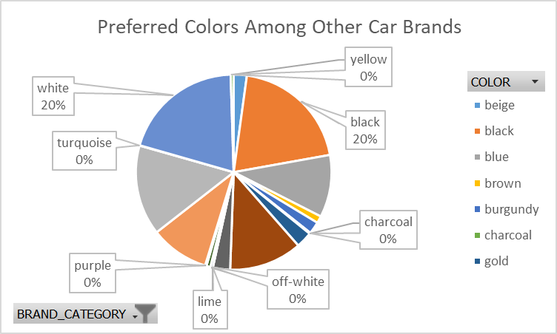
Car BRAND Revenue by COLOR
In other car brands, white and black vehicles are the most popular among buyers, indicating a clear preference for these classic colors. In contrast, colors such as yellow, turquoise, purple, lime, off-white, and charcoal are purchased less frequently, suggesting lower consumer interest in these shades.

Slide 11
Recommendations
Prioritize High-Performing Brands & Models – Focus inventory and marketing on top revenue-generating vehicles.
Optimize Inventory by Mileage – Stock more lightly and moderately used cars; reduce heavily used vehicles.
Align Stock with Regional Demand – Tailor inventory and promotions to regional sales preferences.
Leverage Time-Based Sales Trends – Target campaigns during peak sales periods; offer incentives during slow periods.
Stock Popular Colors & Features – Match vehicles to buyer preferences to increase turnover.
Implement Data-Driven Pricing & Promotions – Use historical sales data for competitive pricing and strategic promotions.
Monitor Performance Continuously – Track brand revenue, inventory turnover, and adjust strategies in real time.

Slide 12
Conclusion
The analysis of the “Bright Car Sales” dataset has provided valuable insights into sales trends across brands, models, mileage, regions, time periods, and colors.
These insights highlight key drivers of revenue and identify opportunities to optimize inventory, pricing, and marketing strategies.
By focusing on high-performing brands, aligning stock with customer preferences and regional demand, leveraging time-based trends, and implementing data-driven pricing strategies, Bright Motors can enhance both profitability and operational efficiency.
Continuous monitoring and adjustment based on data will ensure that strategic decisions remain informed, agile, and aligned with business objectives, supporting sustained growth and competitive advantage in the automotive market.

